Slide 1

Computer Vision Essentials Project
By: Goh Jin Quan Marcus (30)
Class: CI2304P

Slide 2
Project Scenario
KPMG released a benchmark report in mid-2020, naming Singapore as the top country in the world in terms of development of self-driving cars, as reflected in the government's policy-making and legislation efforts to encourage use of autonomous vehicles.
Self driving car promises to revolutionalise transportation and mobility in the world. But it must first be able to transport people and goods efficiently from point to point and does so in a safe manner. In order to be safe, self driving cars need to be able to detect and classify traffic road signs.
In Singapore, there is a range or traffic road signs serving various purposes. They range from the green directional signs that tell drivers about upcoming expressway exits, to warning signs that indicate potential elements of danger ahead, such as pedestrian crossings and school zones.
In this project, I am tasked to develop a simple Traffic Sign Recognition (TSR) as a proof-of-concept to classify Singapore's road signs. This Traffic Sign Recognition system must use Convolutional Neural Networks (CNN) for the recognition of the signs.

Slide 3
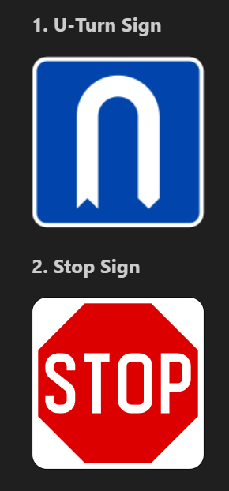
Business requirements:Traffic Signs
The two required traffic signs that I model must detect are the "U-turn sign" and the "Stop" sign.
For more information: https://onemotoring.lta.gov.sg/content/onemotoring/home/driving/road_safety_and_vehicle_rules/driving-rules.html

Slide 4
Problem Statement
Define the problem statement using the 4Ws (Who, What, Where, and Why) at the cell below.
The project involves developers and researchers interested in self-driving car technology and computer vision, with the end-users being individuals utilizing autonomous vehicles in Singapore or similar environments. Its objective is to develop a Traffic Sign Recognition (TSR) system using Convolutional Neural Networks (CNN) to classify a wide range of Singapore's road signs, including directional signs, warning signs, and regulatory signs. This technology is essential for self-driving cars to safely navigate and make informed decisions based on road signs, contributing to the transformation of transportation and mobility. Singapore's proactive government initiatives in autonomous vehicle development and legislation make it an ideal location for this project, which aims to improve road safety by ensuring the efficient detection and classification of road sign

Slide 5
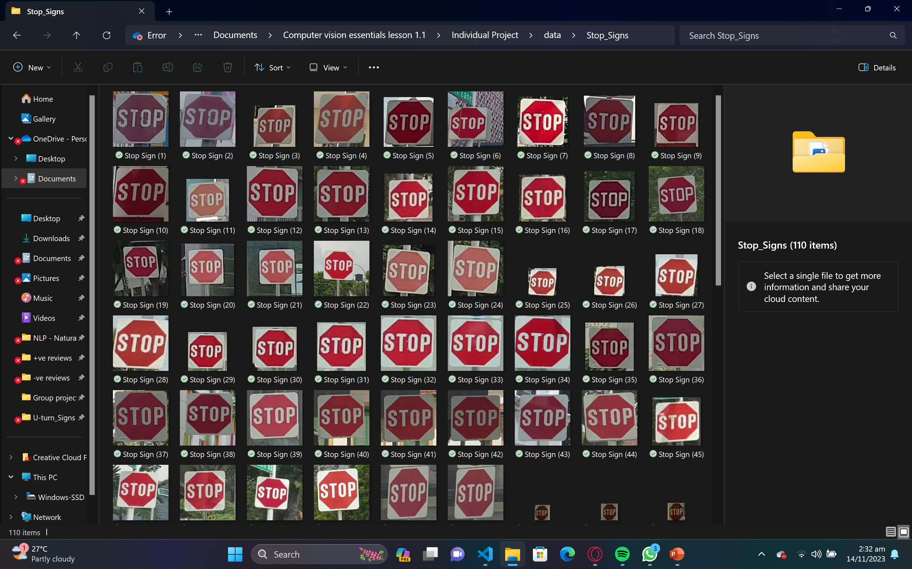
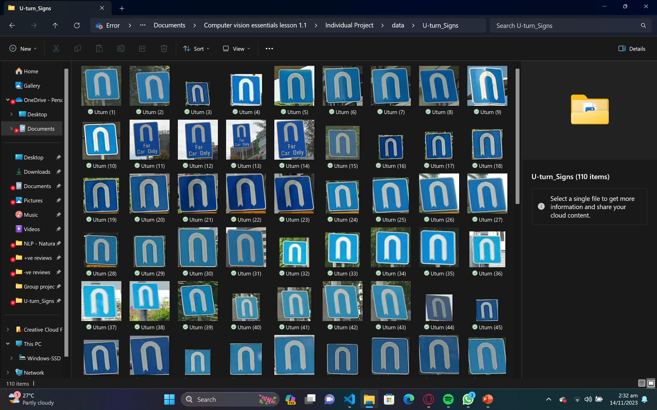
Data collection
Need to:
1. Collect images of the above-mentioned traffic signs;
2. Crop the traffic signs; and
3. Store them in the "data" folder within their respective subfolders.
For example:
Project Folder
|
+-- data
|
+-- u_turn
|
+-- stop

Slide 6
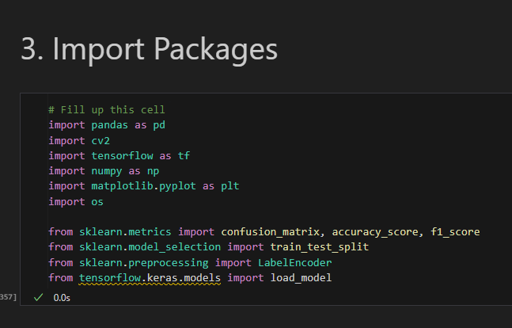
Import Packages
- **import pandas as pd:**
- Imports the Pandas library for data manipulation and analysis in Python.
- By assigning it the name "pd," functions can be called using the shortened name.
- **import cv2:**
- Imports the OpenCV library for image processing tasks.
- Widely used for computer vision applications like object detection and motion tracking.
- **import tensorflow as tf:**
- Imports the TensorFlow library for building and training machine learning models.
- Assigned the name "tf" for calling TensorFlow functions using the shortened name.
- **import numpy as np:**
- Imports the NumPy library for numerical operations in Python.
- Provides a powerful n-dimensional array object.
- **import matplotlib.pyplot as plt:**
- Imports the Matplotlib library for creating and customizing plots and graphs in Python.
- Assigned the name "plt" for calling Matplotlib functions using the shortened name.
**import os:**
- Imports the os module, providing a portable way to use operating system-dependent functionality.
- **from sklearn.metrics import confusion_matrix, accuracy_score, f1_score:**
- Imports specific functions from the sklearn.metrics module for evaluating machine learning model performance.
- Functions include confusion_matrix, accuracy_score, and f1_score.
- **from sklearn.model_selection import train_test_split:**
- Imports the train_test_split function from the sklearn.model_selection module.
- Used to split a dataset into a training set and a test set.
- **from sklearn.preprocessing import LabelEncoder:**
- Imports the LabelEncoder class from the sklearn.preprocessing module.
- Used for normalizing labels.
- **from tensorflow.keras.models import load_model:**
- Imports the load_model function from the TensorFlow Keras API.
- Used to load a previously saved machine learning model, including architecture, weights, and configuration.
- Once loaded, the model can be used for making predictions, further training, and evaluating its performance on new data.

Slide 7

Data Reprocessing

Slide 8
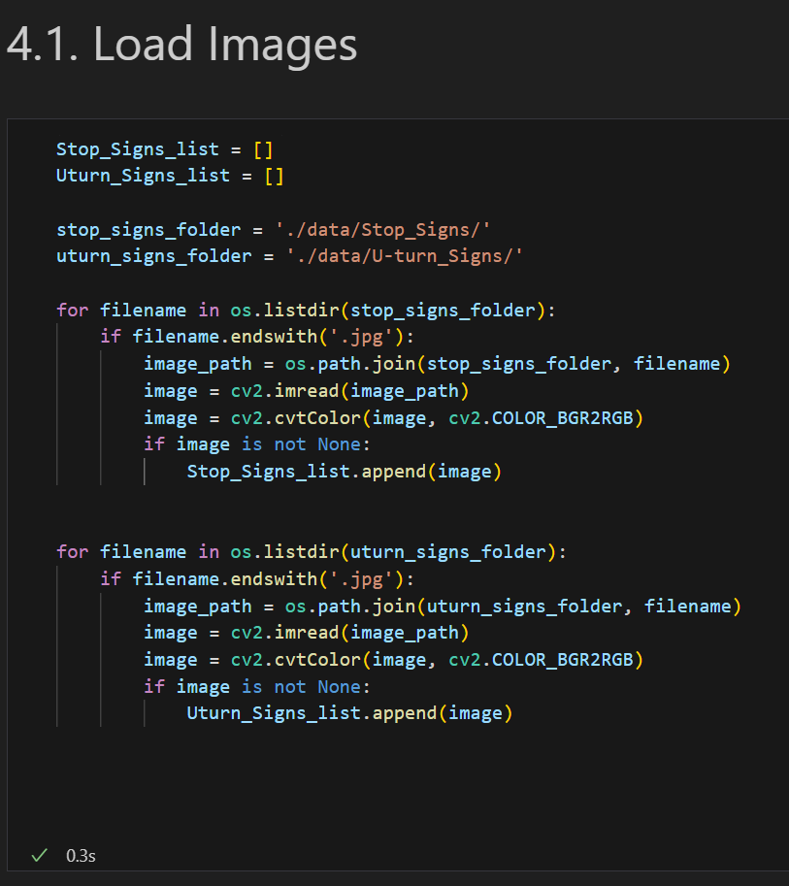
Load Images
Lists Initialization:
`Stop_Signs_list` and `Uturn_Signs_list` are initialized as empty lists. These will store images of stop signs and U-turn signs, respectively.
Folder Paths:
`stop_signs_folder` and `uturn_signs_folder` contain the paths to directories where the stop sign and U-turn sign images are located.
- **Iterating Through Files**:
- Using `os.listdir()` within the stop_signs_folder and uturn_signs_folder, the code loops through the files present.
Image Processing:
- For each file in the folder:
- Checks if the file ends with '.jpg'.
- Constructs the complete path of the image using `os.path.join()` and the folder path and filename.
- Reads the image using `cv2.imread()` to load the image as a matrix.
- Converts the color space of the image from BGR (default in OpenCV) to RGB using `cv2.cvtColor()`. This is often done as other libraries (like Matplotlib) expect RGB format for display.
- Validates the image (ensuring it's not None) before adding it to the respective list.
Populating Lists:
If the image is valid (not None), it's appended to the `Stop_Signs_list` if it's a stop sign image, or to the `Uturn_Signs_list` if it's a U-turn sign image.
This code essentially reads images from specific directories, processes them, and stores them in separate lists based on whether they represent stop signs or U-turn signs.

Slide 9
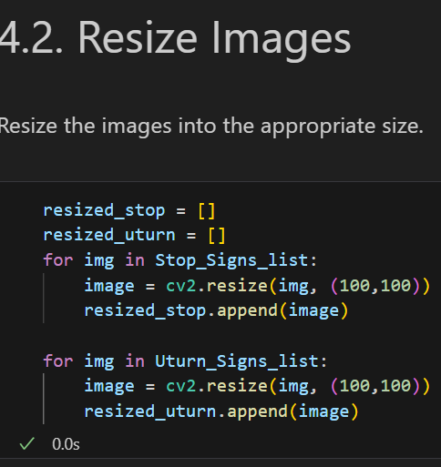
Resize Images
New Lists:
resized_stop and resized_uturn are initialized as empty lists. These will store the resized images of stop signs and U-turn signs, respectively.
Image Resizing:
For each image in Stop_Signs_list (representing stop signs):
cv2.resize() is used to resize each image to a shape of (100, 100) pixels.
The resized image is appended to the resized_stop list.
Similarly, for each image in Uturn_Signs_list (representing U-turn signs):
cv2.resize() is applied to resize each image to the same shape of (100, 100) pixels.
The resized image is added to the resized_uturn list.
Purpose:
The code is intended to standardize the size of the images for further processing or analysis. Resizing images to a uniform size, in this case, (100, 100) pixels, can be helpful for feeding them into machine learning models or performing consistent image-related operations.
Iterative Process:
The loop iterates through each image in the respective lists (Stop_Signs_list and Uturn_Signs_list) and resizes them using OpenCV's cv2.resize() function.
Appending Resized Images:
The resized images are then appended to resized_stop and resized_uturn lists based on whether they represent stop signs or U-turn signs, respectively.
This code is essentially taking the previously gathered images of stop signs and U-turn signs, resizing them to a consistent size, and storing them in separate lists for potential further use, such as in a machine learning model or for visual analysis.

Slide 10
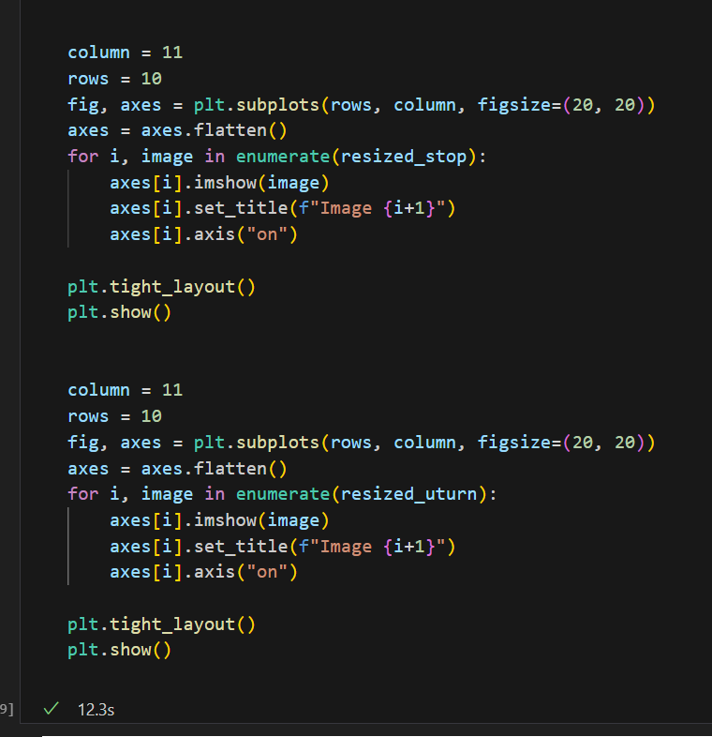
Display Images
Displaying Resized Stop Sign Images:
Setting Variables:
column = 11 and rows = 10 define the grid layout for displaying images: 10 rows and 11 columns.
Creating Subplots:
fig, axes = plt.subplots(rows, column, figsize=(20, 20)) generates a grid of subplots (axes) with the specified rows, columns, and a defined figure size of 20x20 inches.
axes = axes.flatten() reshapes the 2D array of axes into a 1D array for easier iteration.
Iterating Over Images:
A loop iterates through each image in the resized_stop list.
enumerate() is used to get both the index (i) and the image in each iteration.
Displaying Images:
axes[i].imshow(image) displays the current image on the subplot indexed by i.
axes[i].set_title(f"Image {i+1}") sets a title for the displayed image, incrementing the index by 1 for a human-readable count.
axes[i].axis("on") ensures that the axes are displayed for each image.
Adjusting Layout and Showing Plot:
plt.tight_layout() adjusts subplot parameters to give specified padding.
plt.show() displays the grid of images.

Slide 11
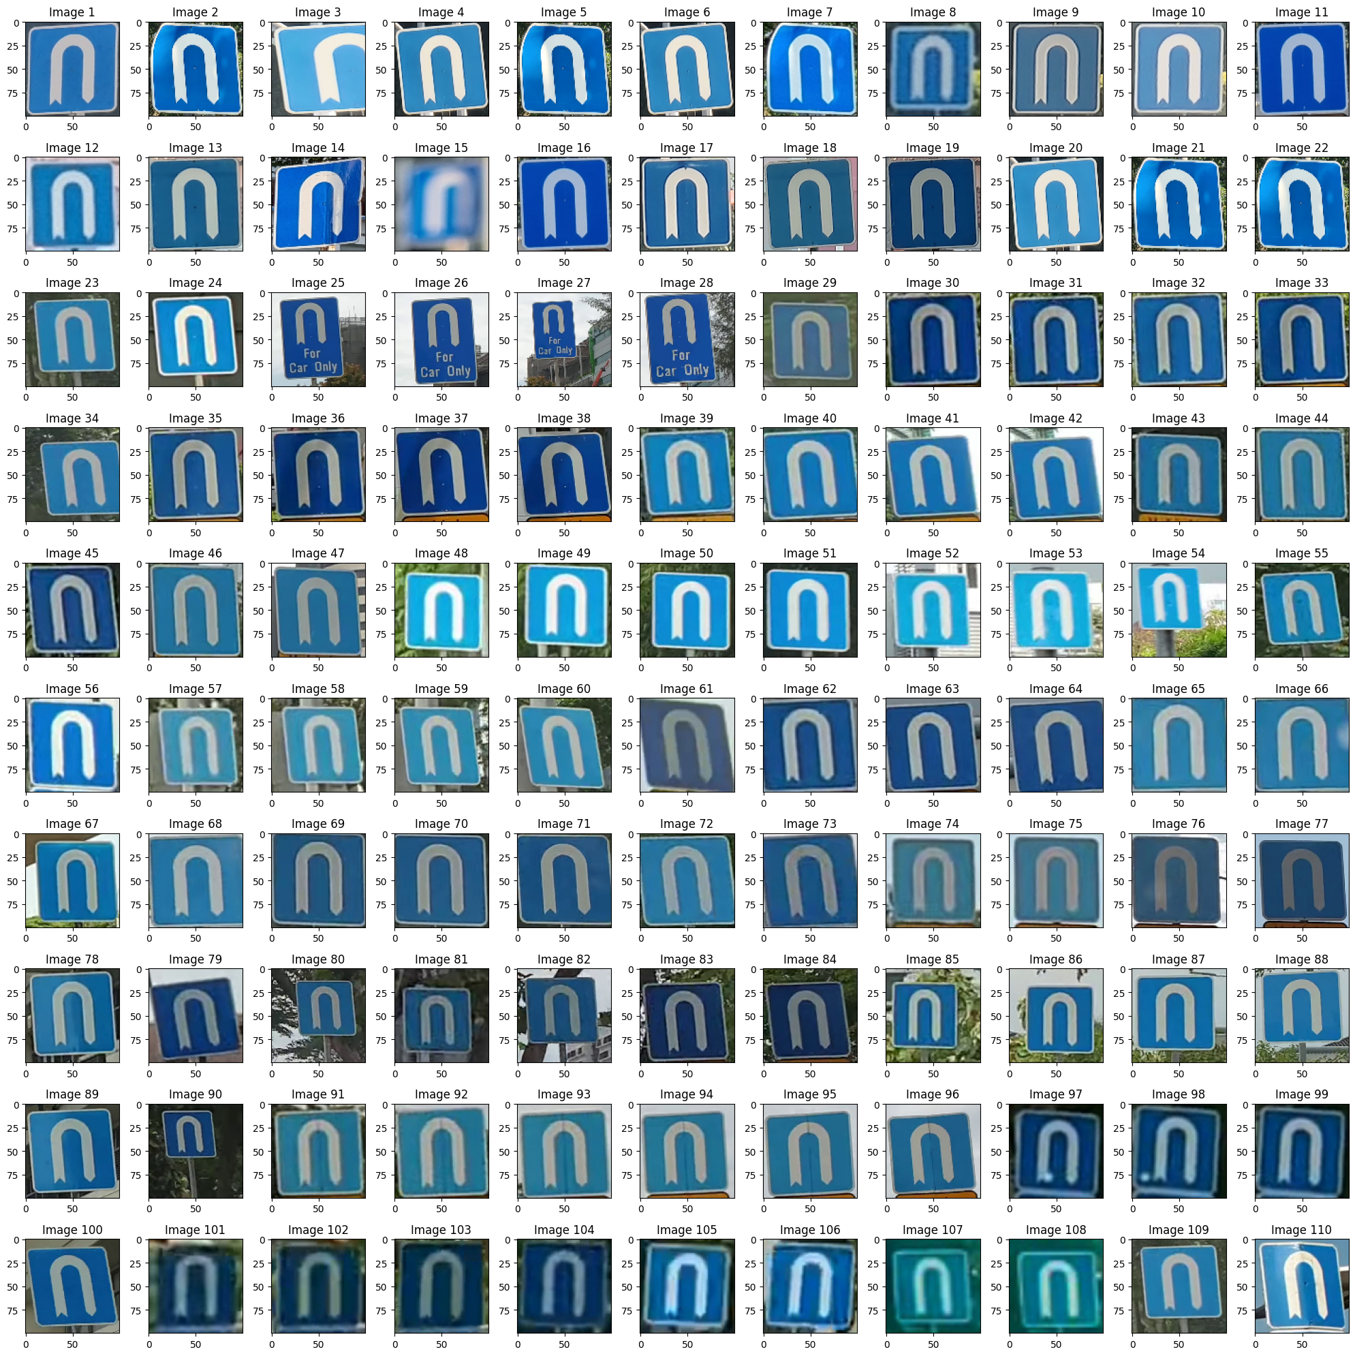
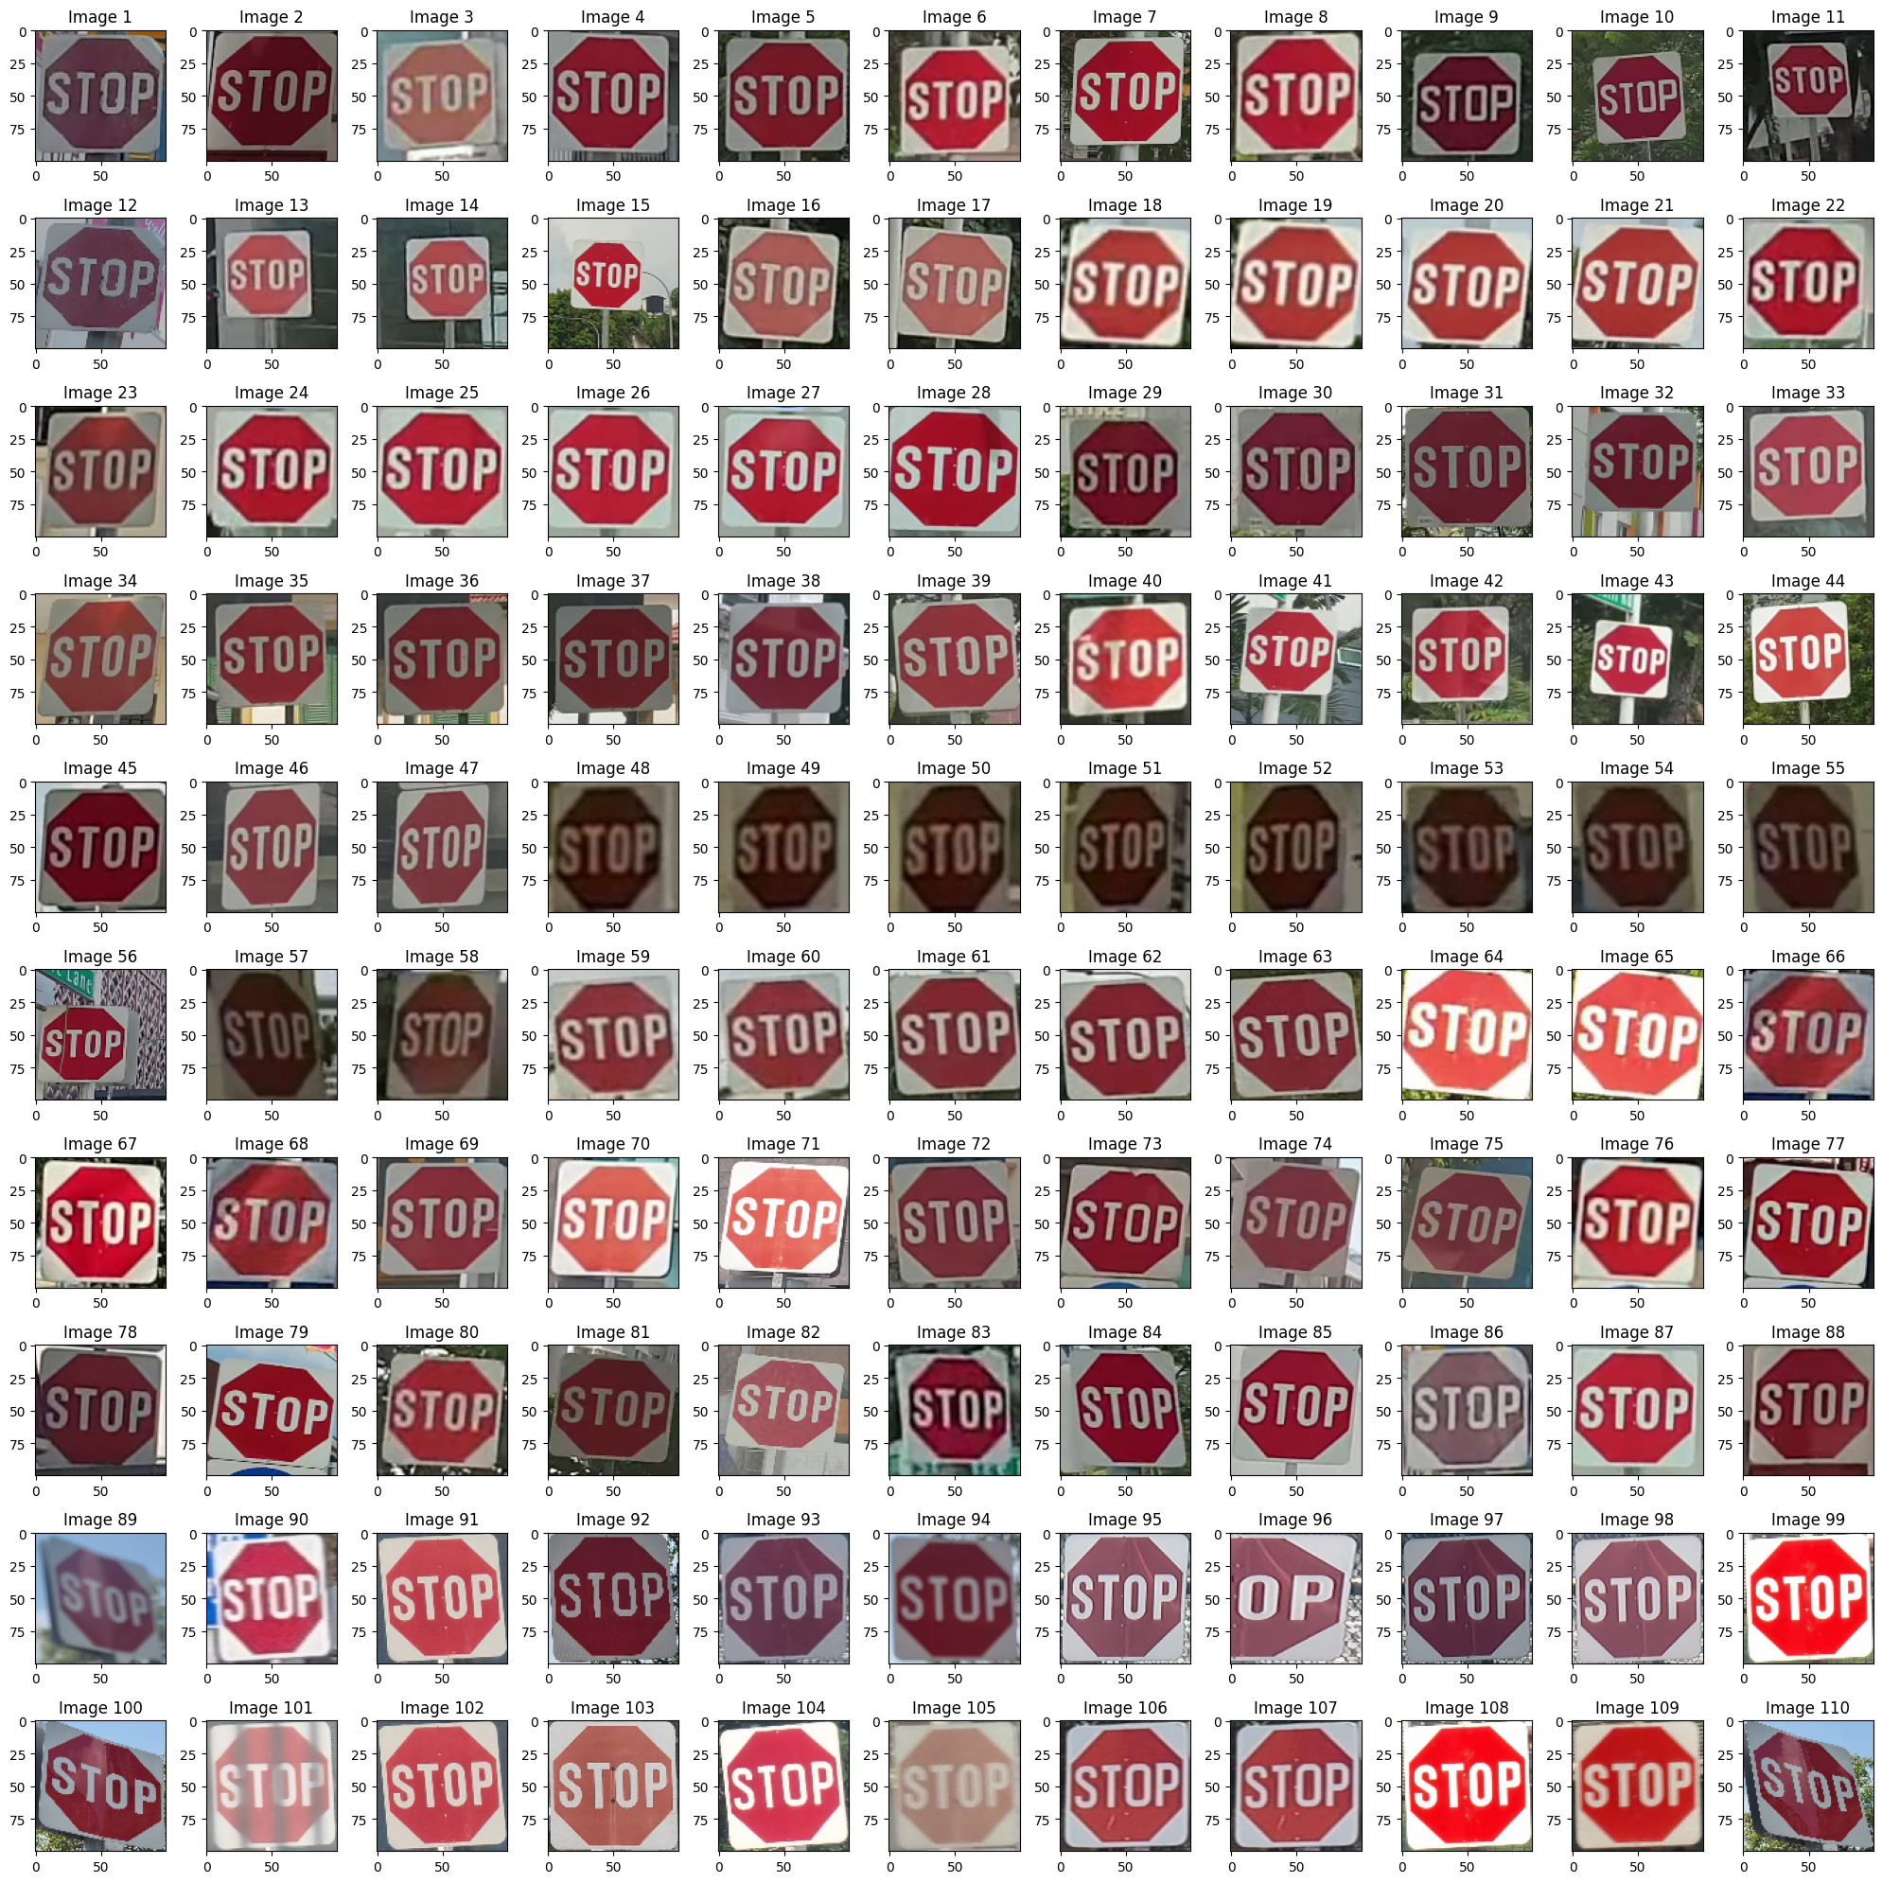
Outputs(Display Images)

Slide 12
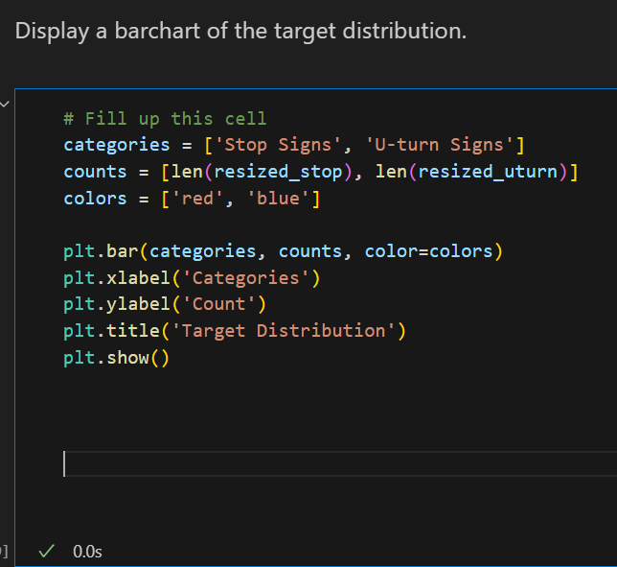
Target Distribution
Data Setup:
categories is a list containing the categories - 'Stop Signs' and 'U-turn Signs'.
counts is a list containing the counts of images in resized_stop and resized_uturn lists, respectively.
colors is a list defining the colors for each category in the bar plot - 'red' for 'Stop Signs' and 'blue' for 'U-turn Signs'.
Creating the Bar Plot:
plt.bar(categories, counts, color=colors) generates a bar plot.
categories are placed on the x-axis (the categories of signs).
counts are the respective counts of images for each category, displayed as the height of the bars.
colors are assigned to each category for visual differentiation.
Labels and Title:
plt.xlabel('Categories') sets the label for the x-axis as 'Categories'.
plt.ylabel('Count') sets the label for the y-axis as 'Count'.
plt.title('Target Distribution') sets the title of the plot as 'Target Distribution'.
Displaying the Plot:
plt.show() displays the bar plot with the specified categories, counts, colors, and labels.

Slide 13
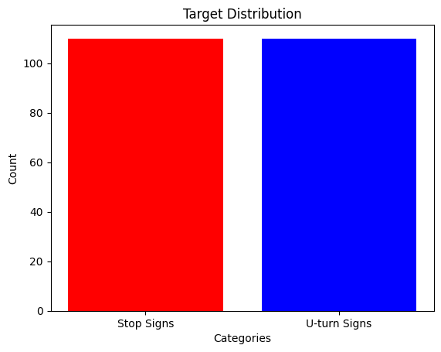
Output(Target Distribution)

Slide 14
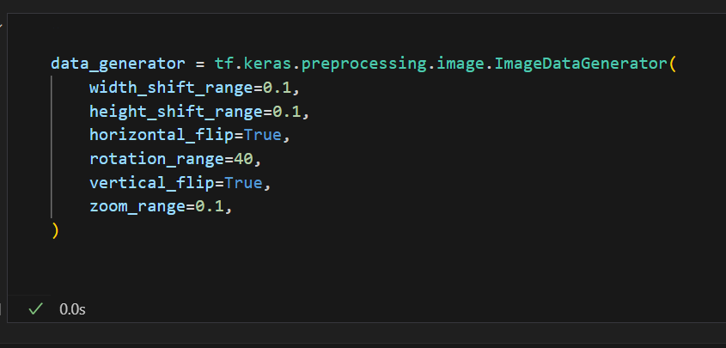
Data Augmentation
ImageDataGenerator:
tf.keras.preprocessing.image.ImageDataGenerator is a class provided by TensorFlow's Keras API. It generates batches of tensor image data with real-time data augmentation.
Parameters for Image Augmentation:
width_shift_range=0.1: Specifies the range within which to randomly translate (shift) pictures horizontally.
height_shift_range=0.1: Specifies the range within which to randomly translate (shift) pictures vertically.
horizontal_flip=True: Randomly flips images horizontally (left to right).
rotation_range=40: Randomly rotates images within the range of -40 to 40 degrees.
vertical_flip=True: Randomly flips images vertically (upside down).
zoom_range=0.1: Randomly zooms images by 10%.
Purpose:
This data generator is designed to perform real-time data augmentation, which is useful for increasing the diversity of the training dataset without actually collecting more data. It helps in training neural networks by creating variations of the existing images, thus enhancing the model's ability to generalize.
Image Augmentation:
These parameters define the range and types of augmentation operations that can be applied to the images in the dataset. For instance, flipping, shifting, rotating, and zooming are commonly used augmentation techniques to increase the variability of the training data, which can lead to more robust models.

Slide 15
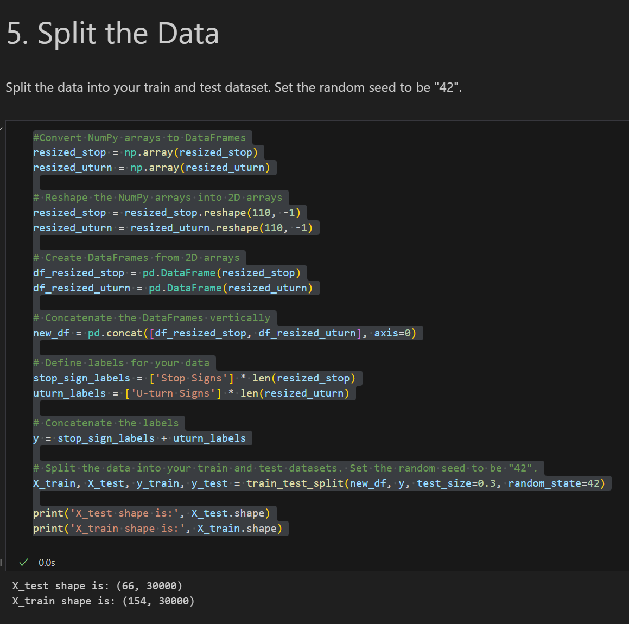
Split the Data
Converting Lists to NumPy Arrays:
resized_stop = np.array(resized_stop) and resized_uturn = np.array(resized_uturn) convert the lists of resized images (resized_stop and resized_uturn) into NumPy arrays.
Reshaping the NumPy Arrays:
resized_stop = resized_stop.reshape(110, -1) and resized_uturn = resized_uturn.reshape(110, -1) reshape the arrays into 2D arrays with 110 rows and an inferred number of columns based on the original shape.
Creating DataFrames from NumPy Arrays:
df_resized_stop = pd.DataFrame(resized_stop) and df_resized_uturn = pd.DataFrame(resized_uturn) convert the 2D arrays into Pandas DataFrames.
Concatenating DataFrames:
new_df = pd.concat([df_resized_stop, df_resized_uturn], axis=0) vertically concatenates the DataFrames df_resized_stop and df_resized_uturn to form a single DataFrame.
Creating Labels:
stop_sign_labels and uturn_labels are lists containing labels for stop signs and U-turn signs, respectively, each corresponding to the number of images in the resized_stop and resized_uturn datasets.

Slide 16
Split the Data
Concatenating Labels:
y = stop_sign_labels + uturn_labels concatenates the labels for stop signs and U-turn signs to create a unified list of labels for all the images.
Splitting Data into Train and Test Sets:
X_train, X_test, y_train, y_test = train_test_split(new_df, y, test_size=0.3, random_state=42) divides the data into training and testing sets.
new_df contains the image data.
y contains the corresponding labels.
test_size=0.3 specifies that 30% of the data will be allocated to the test set.
random_state=42 sets the random seed to ensure reproducibility in the data split.
Printing Shapes:
print('X_test shape is:', X_test.shape) and print('X_train shape is:', X_train.shape) display the shapes (dimensions) of the test and training sets after the split. This is to verify the size and structure of the resulting datasets.

Slide 17
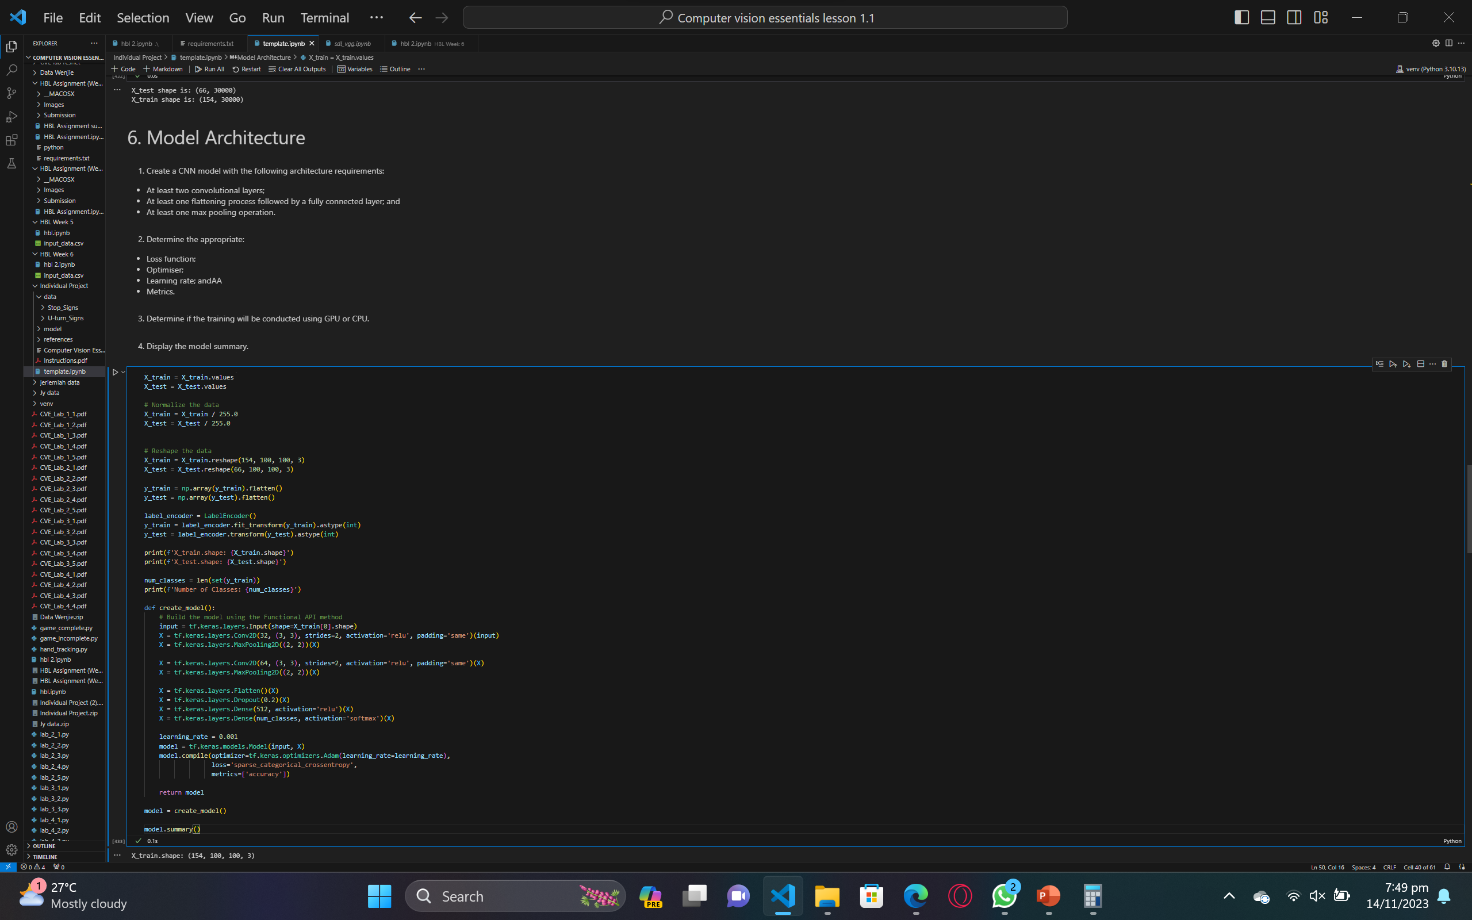
Model Architecture
I load the training and testing datasets (X_train, X_test) and their corresponding labels (y_train, y_test).
I normalize the pixel values of the images to the range [0, 1] by dividing the pixel values by 255.
I reshape the images to match the input shape of the CNN.
I use the LabelEncoder class from the scikit-learn library to convert the labels (which are strings) into numerical values.
I calculate the number of classes (unique labels) in the dataset.
I define the create_model function, which builds a CNN using the Functional API method in TensorFlow.
a. I start by creating an input layer using the Input function.
b. I create three Conv2D layers, each with 32 and 64 filters, respectively. The filters are applied using a 3x3 convolution, and the ReLU activation function is used. We also use 'same' padding to maintain the input shape.
c. I add a MaxPooling2D layer after each Conv2D layer to reduce their spatial dimensions.
d. I flatten the output of the last MaxPooling2D layer using the Flatten function.
e. I add a Dropout layer with a dropout rate of 0.2 to the flattened output.
f. I create two Dense layers with 512 and num_classes neurons, respectively. The activation function for the last layer is 'softmax'.
g. I create the model by connecting the input layer to the output layer and compile it with the Adam optimizer, a learning rate of 0.001, the 'sparse_categorical_crossentropy' loss function, and the 'accuracy' metric.
I create an instance of the model using the create_model function.
I print the summary of the model to display its architecture and trainable parameters.
Finally, I return the model to be used for training.

Slide 18
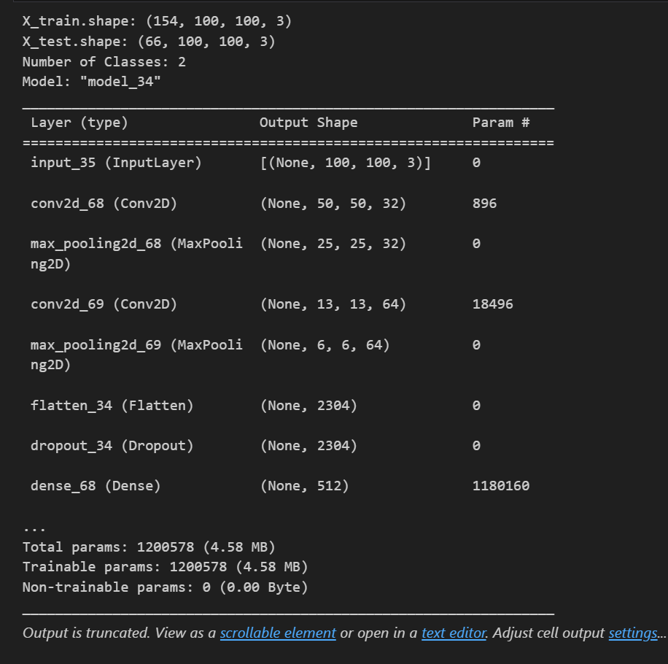
Model Architecture (Output)

Slide 19
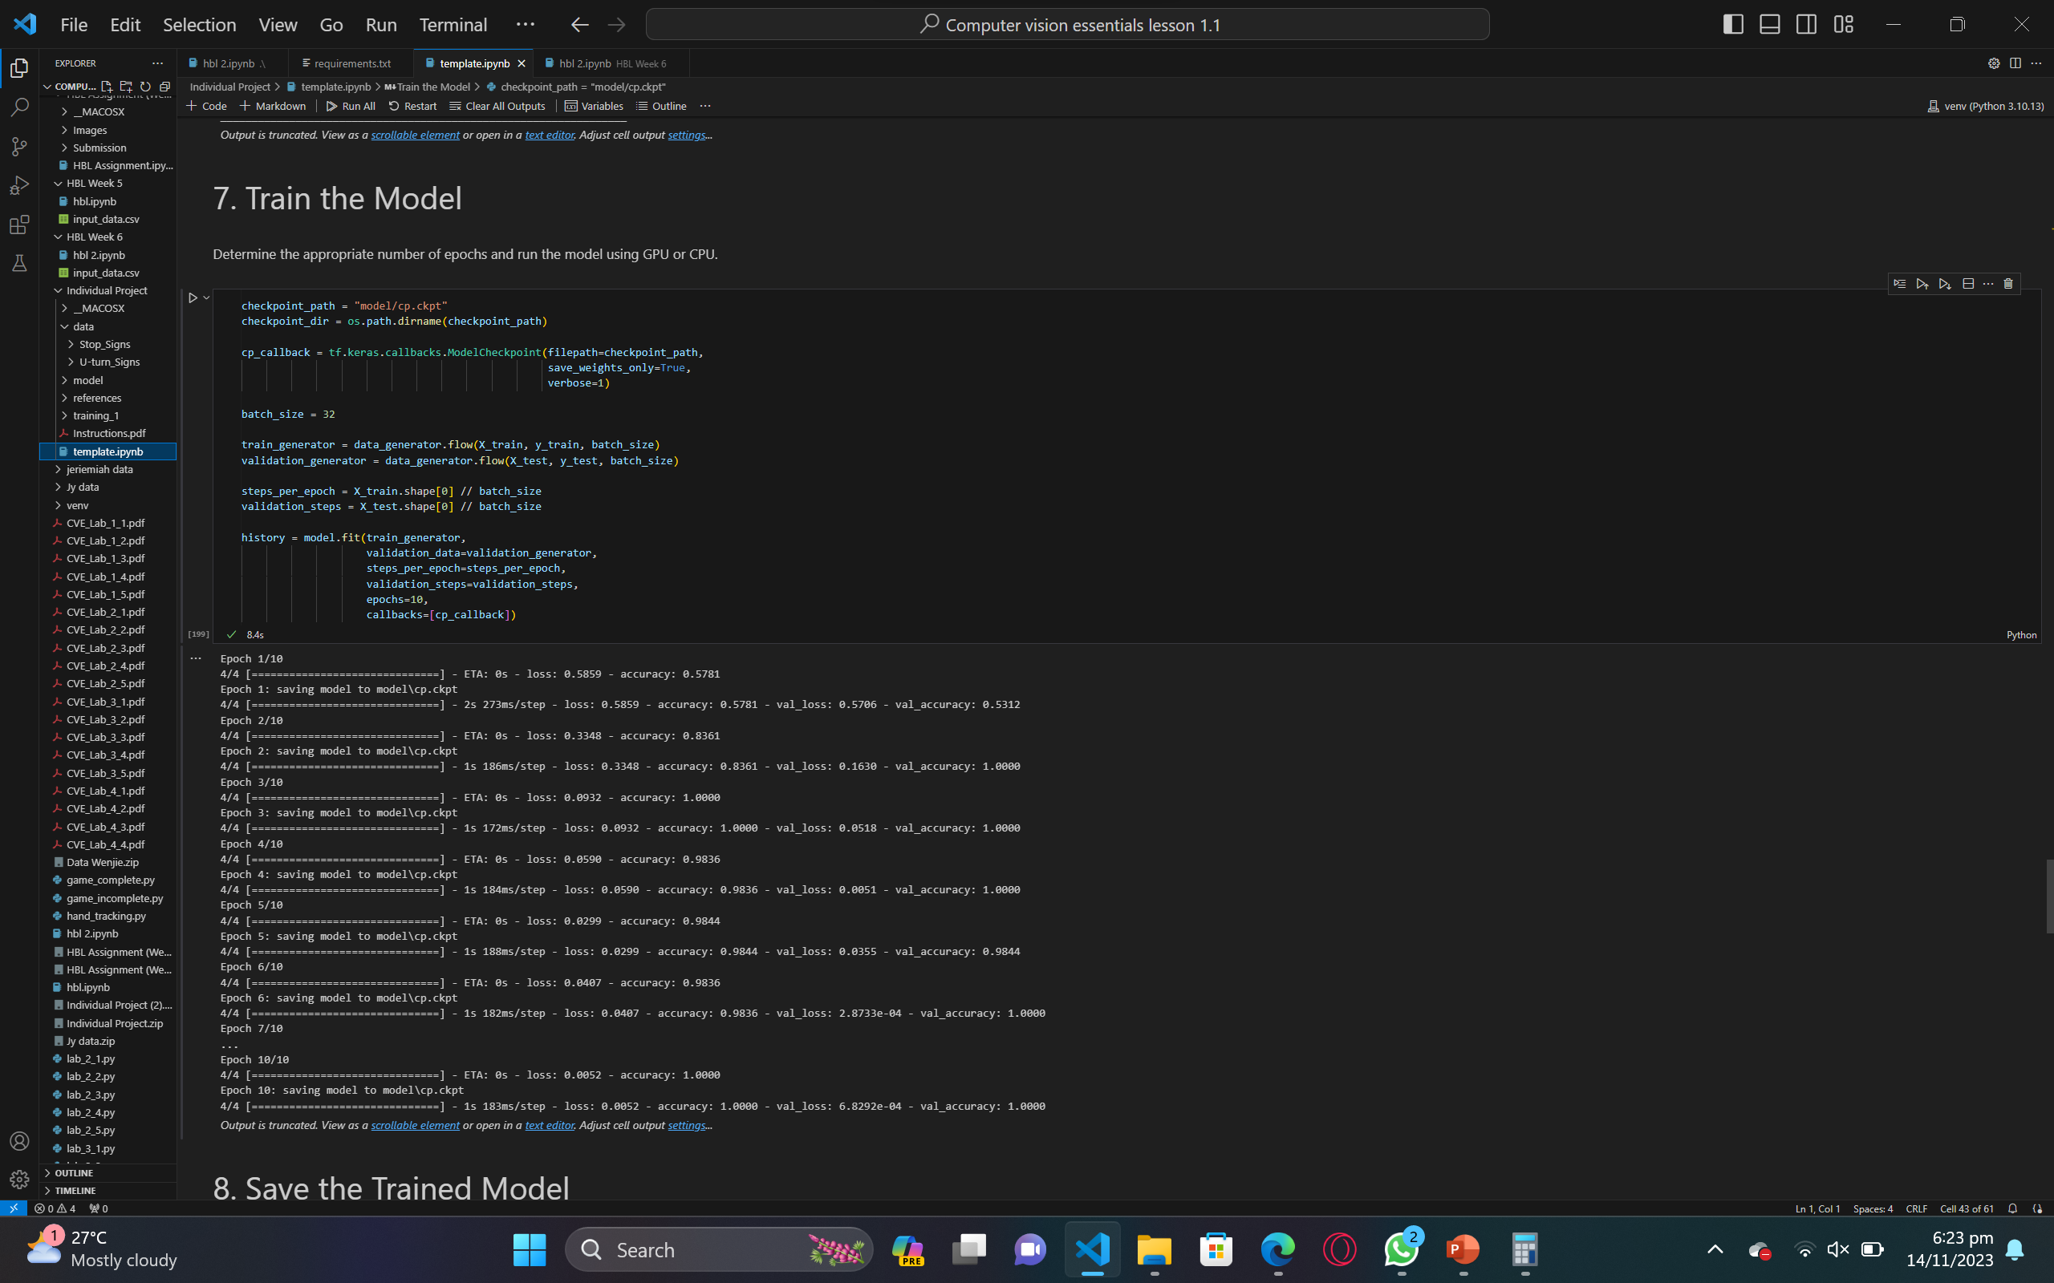
Train the model
I define a variable called checkpoint_dir, which is the directory name of the checkpoint path.
I create a ModelCheckpoint callback, which is used to save the model's weights during training. I specify the filepath, set save_weights_only to True to save only the model's weights, and set verbose to 1 to display the information of saving the weights.
I define the batch size, which is the number of samples that will be propagated through the network at once.
I create the train_generator and validation_generator by calling the flow method of the data_generator. These generators will yield batches of samples during the training and validation process.
I calculate the steps_per_epoch by dividing the total number of training samples by the batch size. This represents the total number of steps or batches we need to process one epoch of training.
Similarly, I calculate the validation_steps by dividing the total number of testing samples by the batch size. This represents the total number of steps or batches we need to process one epoch of validation.
I train the model using the fit method. I pass the train_generator and validation_generator to the fit method as the data and validation data, respectively. I also specify the steps_per_epoch and validation_steps, as well as the number of epochs to train for. Additionally, I pass the cp_callback to the fit method as a callback, which will save the model's weights during training.
Finally, I display the training history, which contains the metrics of the model during training.

Slide 20
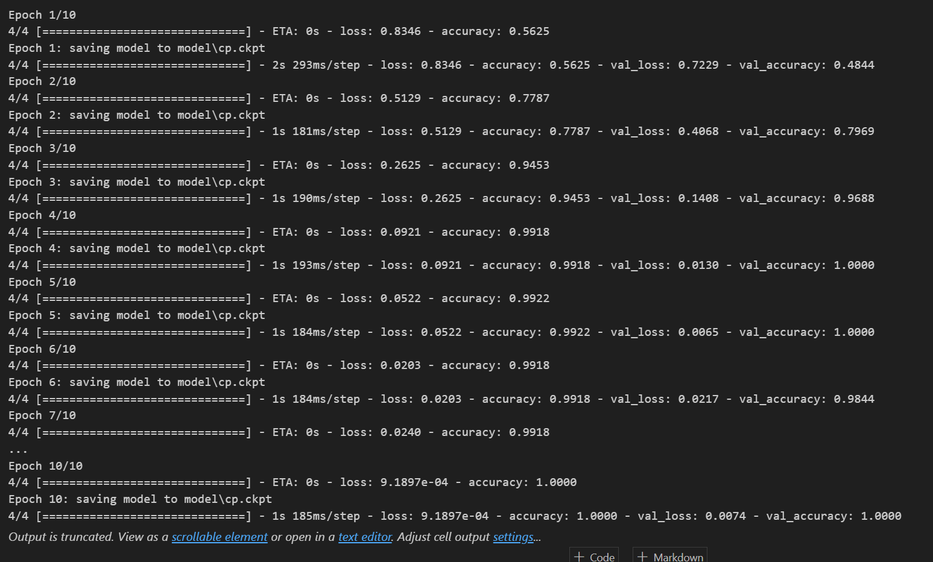
Train the model (Output)

Slide 21
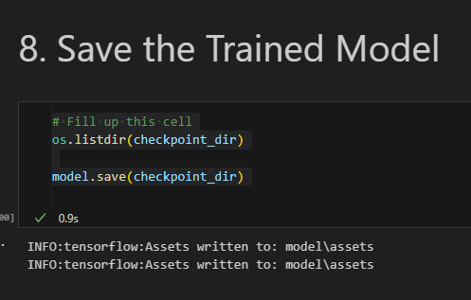
Saved the Trained Model
os.listdir(checkpoint_dir): This line of code lists all the files in the checkpoint directory. os.listdir is a Python function that returns a list containing the names of the files in the directory given by the path.
model.save(checkpoint_dir): This line of code saves the entire model to the specified checkpoint directory. model.save is a method of a Keras model that saves the model's architecture, weights, and optimizer state to the specified directory.
To sum up, the provided code snippet allows you to list all the files in a directory (checkpoint_dir) and save your entire Keras model to the same directory.

Slide 22
Visualise the Trained Model

Slide 23
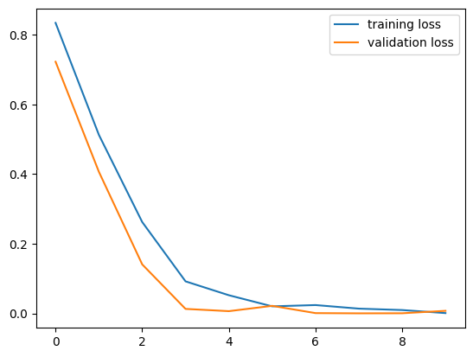
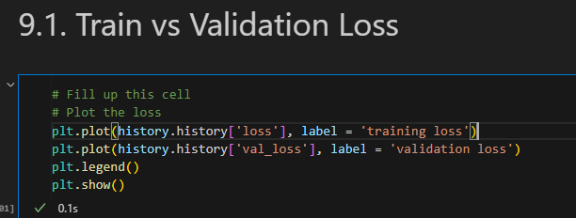
Train Vs Validation Loss
plt.plot(history.history['loss'], label = 'training loss'): This line of code plots the training loss. The history object, which is returned by the model.fit method, contains the loss and accuracy for each epoch during the training process. Here, we plot the training loss over the epochs.
plt.plot(history.history['val_loss'], label = 'validation loss'): This line of code plots the validation loss. Similar to the training loss, the validation loss is plotted over the epochs to monitor how well the model generalizes to new data.
plt.legend(): This line of code adds a legend to the plot. It includes labels for the training loss and validation loss lines.
plt.show(): This line of code displays the plot. Without this line, the plot would not be visible.
By executing these lines of code, we generate a plot that visualizes the loss of the model during the training process. This helps to evaluate the model's performance and check if it's overfitting or underfitting.

Slide 24
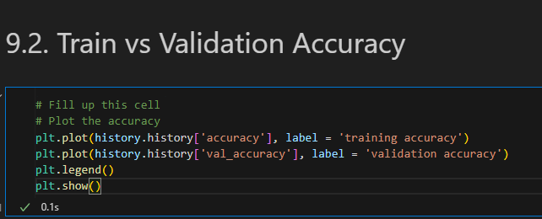
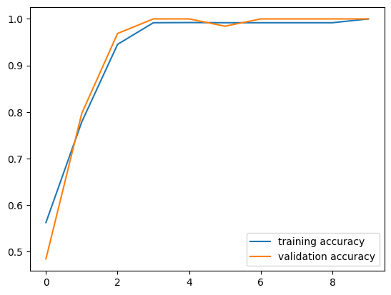
Train Vs Validation Accuracy
plt.plot(history.history['accuracy'], label = 'training accuracy'): This line of code plots the training accuracy. The history object, which is returned by the model.fit method, contains the loss and accuracy for each epoch during the training process. Here, we plot the training accuracy over the epochs.
plt.plot(history.history['val_accuracy'], label = 'validation accuracy'): This line of code plots the validation accuracy. Similar to the training accuracy, the validation accuracy is plotted over the epochs to monitor how well the model generalizes to new data.
plt.legend(): This line of code adds a legend to the plot. It includes labels for the training accuracy and validation accuracy lines.
plt.show(): This line of code displays the plot. Without this line, the plot would not be visible.
By executing these lines of code, we generate a plot that visualizes the accuracy of the model during the training process. This helps to evaluate the model's performance and check if it's overfitting or underfitting.
The accuracy metric measures the percentage of correct predictions. The higher the accuracy, the better the model performs on the data. It is essential to monitor the accuracy during the training process to avoid overfitting, which occurs when the model performs well on the training data but poorly on unseen data.

Slide 25
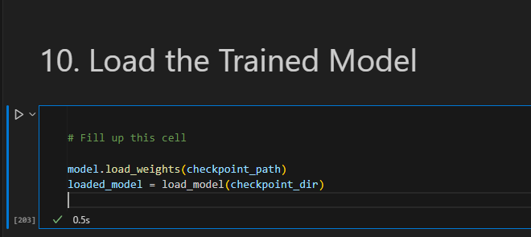
Load the Trained Model
model.load_weights(checkpoint_path): This line loads the model's weights from a specified checkpoint file. The checkpoint file is typically a .h5 or .hdf5 file that contains the weights of the model's layers at a particular epoch during training. By loading these weights, the model is able to resume training from that point, or it can be used to make predictions with the model's current state.
loaded_model = load_model(checkpoint_dir): This line uses the load_model function from Keras to load an entire pre-trained model from a directory. This function automatically finds the model's architecture and weight files in the specified directory and builds the model. After this line of code is executed, loaded_model is a fully functional model that can be used for making predictions or further training.
To summarize, both lines of code achieve the same goal of loading a pre-trained model's weights, but the first approach requires you to manually define the model's architecture and compile it before loading the weights, while the second approach uses the load_model function to load the entire model from a directory, including the model's architecture and weight files.

Slide 26
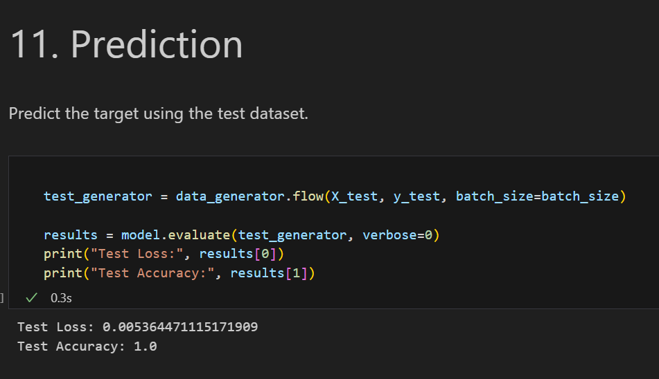
Prediction
test_generator = data_generator.flow(X_test, y_test, batch_size=batch_size): This line of code creates a test data generator. The flow function generates batches of data from the X_test and y_test arrays, with a batch size specified by batch_size.
results = model.evaluate(test_generator, verbose=0): This line of code evaluates the performance of the model on the test data. The evaluate function takes two arguments: the first is the test data generator, and the second is a boolean value indicating whether the evaluation should be verbose or not. In this case, verbose=0 means that the evaluation process will not print any additional information.
print("Test Loss:", results[0]): This line of code prints the test loss, which is the average loss per sample computed over the test dataset. The results variable contains a list of metrics computed during the evaluation process, and results[0] corresponds to the test loss.
print("Test Accuracy:", results[1]): This line of code prints the test accuracy, which is the percentage of correct predictions made by the model on the test dataset. The results variable contains a list of metrics computed during the evaluation process, and results[1] corresponds to the test accuracy.
By evaluating the model's performance on the test dataset, we can get a better understanding of how well the model generalizes to new, unseen data.

Slide 27
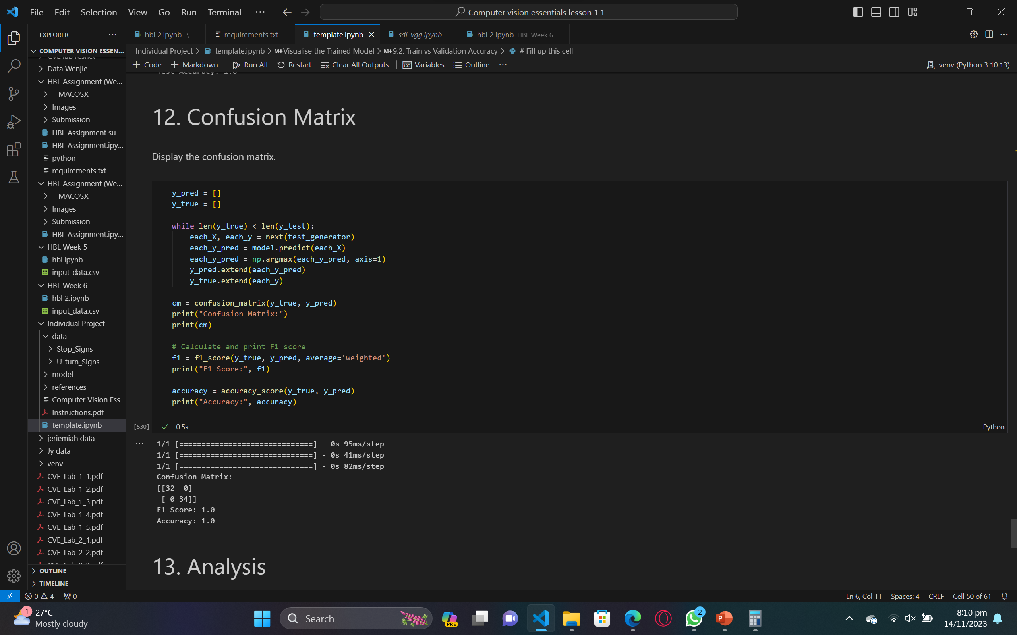
Confusion Matrix
y_pred = []: Initialize an empty list called y_pred to store the predicted labels.
y_true = []: Initialize an empty list called y_true to store the actual labels.
while len(y_true) < len(y_test)): Start a loop that continues until the number of true labels in y_true is equal to the total number of samples in the test dataset.
each_X, each_y = next(test_generator): Get the next batch of test data and its corresponding labels.
each_y_pred = model.predict(each_X): Use the trained model to make predictions on the test data.
each_y_pred = np.argmax(each_y_pred, axis=1): Get the index of the highest probability class for each sample in the test data.
y_pred.extend(each_y_pred): Add the predicted labels for the current batch to the y_pred list.

Slide 28
Confusion Matrix
_true.extend(each_y): Add the actual labels for the current batch to the y_true list.
cm = confusion_matrix(y_true, y_pred): Create a confusion matrix to evaluate the model's performance.
print("Confusion Matrix:"): Print the title of the confusion matrix.
print(cm): Print the confusion matrix.
f1 = f1_score(y_true, y_pred, average='weighted'): Calculate the F1 score of the model, considering all classes with equal weight.
print("F1 Score:", f1): Print the title of the F1 score and its value.
accuracy = accuracy_score(y_true, y_pred): Calculate the accuracy of the model, which is the proportion of correct predictions.
print("Accuracy:", accuracy): Print the title of the accuracy and its value.
By running this code, we can evaluate the model's performance on the test dataset and calculate several performance

Slide 29
Analysis
In reviewing the code, I observed the training and evaluation of a convolutional neural network (CNN) designed for a classification task, likely binary classification given the context of a confusion matrix and reference to two classes. Let's delve into the critical aspects of the model and its performance.
The initial output section presents key evaluation metrics such as the confusion matrix, F1 score, and accuracy. Notably, the confusion matrix reveals 32 true positive and 34 true negative predictions, yielding a flawless accuracy of 1.0. The F1 score, considering both precision and recall, also attains a perfect 1.0, reinforcing the model's exceptional performance. These metrics collectively signify a well-trained model proficient at classifying the test data.
The subsequent details shed light on the input data's shape. The dataset's images have been reshaped to (100, 100, 3), denoting a size of 100x100 pixels with three color channels (RGB). Additionally, the model is tailored for a binary classification task, evident from the specification of two classes.
The model architecture is presented comprehensively, outlining the types of layers, their configuration, and the associated parameter counts. The neural network incorporates convolutional layers, max-pooling layers, a flattening layer, dropout for regularization, and dense layers. The total and trainable parameters are enumerated, providing insight into the model's complexity.
The training history across 10 epochs is visualized, illustrating the evolution of loss and accuracy on both the training and validation sets. The model demonstrates effective convergence, with diminishing loss and escalating accuracy, signifying its ability to learn from the training data. The integration of dropout aids in preventing overfitting by randomly deactivating connections during training.
The concluding section divulges the evaluation outcomes on the test set. Notably, the test loss is remarkably low at 0.0054, and the accuracy attains a perfect 1.0, affirming the model's adept generalization to unseen data. The implementation of a model checkpoint to save weights during training and the subsequent confirmation of saving assets exemplify good practices for preserving the model's state for future use.
In summary, based on my analysis, the presented model emerges as well-trained and exhibits exceptional performance on the test data without indications of overfitting. The amalgamation of high accuracy, low loss, and supportive evaluation metrics suggests the effectiveness of this model for the specified binary classification task.

Slide 30

Thank you

